Slide 1
Disability & Medicaid
Ali McCalmont

Slide 2
Agenda
How to complete the disability page
How to pend for a DDB determination
Presumptive Disability
Childless Adults EMA processing
Disability Determination Received
Best Practices

Slide 3
Completing The Disability Page

Slide 4
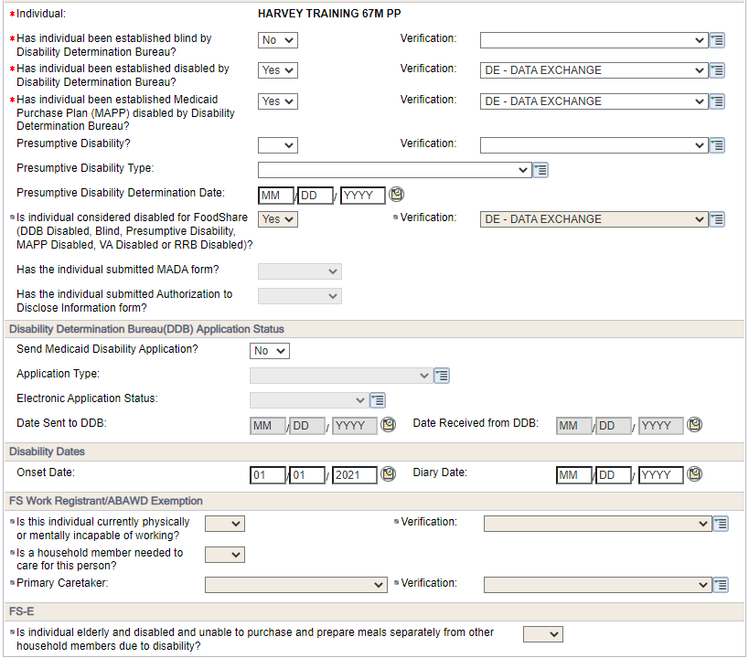
Verified Disability
If an individual has a verified disability with Social Security through Supplemental Security Income or Social Security Disability, a disability page must be entered.

Slide 5
Answer Yes to the appropriate questions.
If an individual has been determined blind, this should be marked if we have that information.
Has the individual been established as disabled by DDB should be marked Yes for anyone with an SSI/SSDI payment.
Has the individual been established MAPP disabled by the DDB should be marked yes as well.
The FoodShare disabled question will default to Yes when you select Yes for the other two questions.

Slide 6
Since the disability is verified, the Application Status section can be marked No.
Refer to SOLQ to obtain a disability onset date
There will not be a diary date for cases with an existing disability through SSA.
If there is FoodShare, the question about currently able to work can be updated to Yes
If they are disabled and need a caretaker, this would require verification per FoodShare policy

Slide 7
Pending for Disability Status

Slide 8
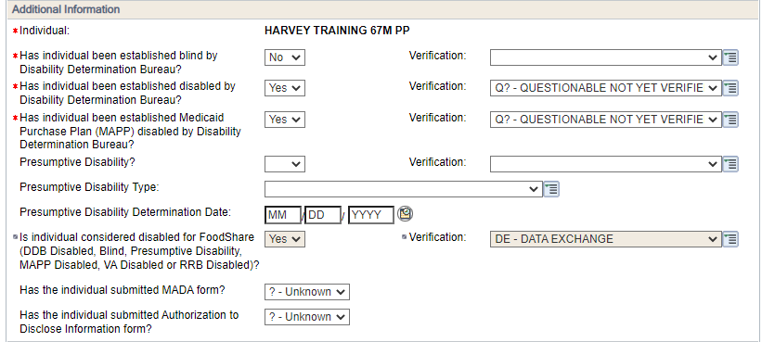
Reported Disability – Initial Request
When an individual does not have a verified disability status through Social Security and has not had a disability determined, the case must be pended and a verification request sent
The questions related to being disabled should be marked yes with a ? Or Q? entered.
The MADA and Authorization questions should also be marked ?
You must mail these forms to the customer
Use the application date as the disability onset date unless the client reports another date.

Slide 9
Other Considerations
If the question related to MAPP is marked yes, there must be a MAPP page entered also.
If there isn’t the ADDD and MADA in ECF, the case will not transmit.
If there is an authorized representative screen and the form is not in ECF, the case will not transmit.
The case must not be pending for anything other than disability, or the case will not transmit.
The client must be non-financially and financially eligible to send the DDB determination (excludes EMA cases)
A green banner will pop up stating the case will be transmitted to the DDB if all items are submitted.

Slide 10
Reported Disability – Paperwork Received
Once we have received the MADA and ADDD, update the questions related to submitting the MADA and ADDD to Yes.
Mark Yes to send the application
Mark NE – New application Electronic
Mark IR – Initiate Request
Run eligibility on the case.
If the case is only pending disability, the case will transmit overnight to the DDB.
Alert 429 generates if the case does not send overnight. Review the case for accuracy and troubleshoot following Process Help 9.4.7 before sending to the call center
WISPACT Trust and Emergency MA requests must be sent manually to the DDB.

Slide 11
Reported Disability – Paperwork Received
If no decision is returned by the 30 day due date for the application, update the case to deny eligibility for lack of disability.
Suppress all notices.
Repend the page and extend the due date out 6 months.
This pulls the case out of intake/case processing mode

Slide 12
Presumptive Disability

Slide 13
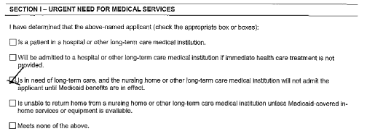
Presumptive Disability
The ADDMD form must be signed by a medical provider and have an urgent need (section 1) and an impairment (section 2) marked.
If it is not signed or they do not meet criteria in one of the sections, we cannot certify them.
If a person submits the ADDMD Presumptive Disability form, we must update the disability page to reflect the type and date of receipt.

Slide 14
Process At A Glance
Presumptive disability status begins the date we received the completed form meeting criteria.
Update the disability page to No disability for the backdated months and the current month if applicable.
Example. Application received 8/10 with a back date request to June. Presumptive disability form is received 9/1. Disability page should be marked No for June/July/August and updated with a 9/22 begin month showing Yes. Run and confirm.
Example: Application received 8/10. Presumptive form received 8/28. Disability page for August should be marked No and updated to Yes with a September begin month. Run and confirm. Manually certify back to 8/28 when the presumptive form was received. Suppress notices and send a manual positive NOD.

Slide 15
Process At A Glance
Once the eligibility is confirmed, update the disability page and remove the presumptive disability information.
Make sure the disability questions are pending
Rerun to pend for a formal disability determination
The agency typically will get notice confirming the presumptive status.
Any backdate request will be address when the formal determination is returned.

Slide 16
Childless Adults EMA Process

Slide 17
Process At A Glance
Individuals without children who do not have citizenship status that allows them eligibility must follow the Disability process under EBD MA rules.
They must be otherwise be eligible non-financially and financially.
Manually mail the paperwork to the DDB at:
Disability Determination Bureau, PO BOX 7886, Madison, WI 53707-7886
If no presumptive has been filed, follow the case processing for cases pending disability. The case will pend citizenship and disability.
If a presumptive has been filed, follow the presumptive process.
Manual certification will be needed for the duration of the Emergency.

Slide 18
Disability Determination Received

Slide 19
Process At A Glance
Once a determination is received, the disability page should be updated.
If denied, update the page and determine eligibility under applicable program rules.
If disability is approved, update the page to reflect they are disabled and enter the diary date from the DDB if applicable. Run and confirm the case.
For EMA cases, the red folder will be sent to the agency. Update the case as applicable and send proper notice of approval or denial.
If approved, please made note of the MAID on the approval notice as EMA cases do not receive a Forward Health card.
This Photo by Unknown Author is licensed under CC BY-SA-NC

Slide 20
Best Practices

Slide 21
Best Practices
Verified Disability
Pending Disability
Presumptive Disability
Be sure all page information is complete.
If there is FoodShare, be sure those items are marked. The budget is calculated differently for EBD individuals.
Disability forms missing a signature can be completed telephonically (PH 9.4.1.5)
EMA and WISPACT cases must be sent manually to the DDB
The case must be otherwise eligible and only pending disability to send to the DDB
Check the case to ensure transmission the next day
Use the troubleshooting steps in PH 9.4.7 before sending to the state
Make sure all forms are coded properly in ECF, including any REP forms
Eligibility begins the day we receive the form.
Suppress any notices to avoid errors and send a manual notice
Certify for the duration of the emergency (use your best judgement)

Slide 22
Questions?

