Slide 1
Wisconsin Residency for FoodShare
Presented by Jenny Booth
05/11/23

Slide 2
Residency
Residency is the act of living in Wisconsin
Residency is a non-financial requirement of FoodShare eligibility
Residency is not the same as an address
There is no minimum amount of time someone needs to live in WI. If they are living in WI, they are a resident

Slide 3
When to Verify WI Residency
The primary person must verify WI residency at application
WI residency must be verified, if deemed questionable, at renewal. If residency is not questionable at renewal, it does not need to be re-verified
Residency cannot be requested, nor can eligibility be terminated, for not providing verification of residency when FS eligibility is ongoing and outside of application and renewal

Slide 4
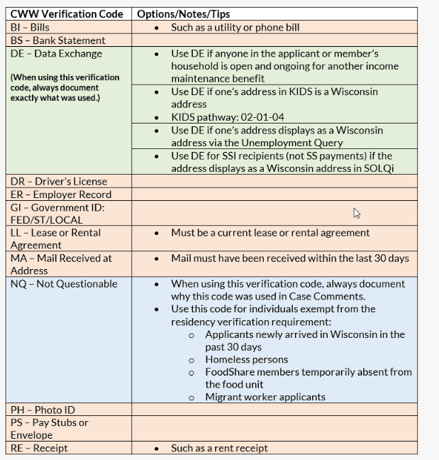
Suggested Verification for Residency
This is not an exhaustive list
Workers should explore data matches and information that is already available prior to pending a case for verification of WI residency
Verification sources can be found in FSHB 1.2.6

Slide 5
When is Residency Questionable?
Reminder- residency can only be re-verified at renewal if it is determined questionable. Ongoing cases cannot be pended for residency verification
When residency is deemed questionable:
An applicant’s residency could not be verified via data exchanges or known information, or
The IM worker requires clarification from the applicant or member due to inconsistencies presented, and
the IM worker needs to pend the case for verification of Wisconsin residency.
Note: out of state EBT Transactions DO NOT make WI residency questionable for FS

Slide 6
Pending for Verification
FoodShare pends for residency only at application and renewal. The following is a breakdown of what happens to the FoodShare case when certain verification codes are used
Using the ?/NV verification codes or the Q?/QV verification codes result in the same eligibility determination at application, renewal, and during an ongoing case
The ? verification code is used at application when Wisconsin residency requires verification
When residency is found questionable at renewal, the Q? verification code is used (otherwise verification should not be requested)

Slide 7
Questions?

