Slide 1
Drug Testing Policy for FoodShare
Presented by Jenny Booth
05/25/23

Slide 2
Objectives
Policy
Worker Action
Customer Action
Testing Method
Scheduling
Case Processing
Evaluating and Entering an Accommodation Request
Processing Drug Test Results
Regaining Eligibility after 12 Month Sanction Period
Tips

Slide 3
FoodShare Policy
The FoodShare drug testing requirements were suspended due to the COVID-19 emergency effective April 17, 2020. As part of COVID-19 Unwinding activities, these requirements are being reinstated starting with applications filed on or after June 12, 2023. Current members that enrolled after April 16, 2020, and who still have a drug felony conviction in the last five years, will need to take and pass a drug test at their next renewal, starting with renewals due in July 2023, to keep getting benefits
Applicants with drug felony conviction within the last 5 years
Must be reported at application, renewal, person-add
Must agree to take and pass a drug test (negative result)
Ineligible for FoodShare if fail to complete and pass drug test
12-month sanction if test is positive (failed)

Slide 4
Worker Action
Ask about drug felony convictions at application, renewal, person-add
Notify customer of drug testing policy, consequences for failing/not taking test and the right to decline aid
Assist with scheduling the test if the applicant or member requests help
Provide accommodation exempting persons from needing to take a drug test when appropriate
Must explore all potential options for assisting the member in meeting the requirement when they report they are unable to complete a drug test
If the member reports they have a religious or cultural reason for not taking a drug test, the agency must grant an accommodation
Inform customers that prescription/non-prescription drugs and some foods may cause a positive test result
Case comment all actions taken

Slide 5
Customer Action
Must agree to take and pass drug test to be eligible for FoodShare
If they pass (result is negative), they remain eligible- no additional test will be required
If they fail the test (result is positive), they are sanctioned for 12 months starting the next possible benefit month. If they have been sanctioned for 12-months, they must serve their sanction before they can reapply and retest
If they decline to submit to a drug test or fail to complete the test within 30 days, they are ineligible effective the next benefit month. They may reapply and complete the test at any time
Must take test in a timely manner so that results are received by the IM agency within 30 days of the filing date (application) or from the date the worker notified the customer of the drug testing requirement
If positive (failed) result is due to legally prescribed medication, provide proof of valid prescription within 30 days from testing positive

Slide 6
Testing Method
The method of drug testing is to be urine or oral swabs, at a minimum, a 7-panel drug test is to be used and must test for marijuana, amphetamines, cocaine and opiates. Any test (rapid or sent to a lab) that meets these requirements is acceptable
If the testing entity is onsite, such as through the public health department or results are received over the phone (collateral contact), clearly document in case comments the member’s name, date, pass/fail result, and the entity that administered the test. If results are received via a document or email, case comment the pass/fail result and add the document/email to the case file
If a drug test was administered by an acceptable entity within the last 30 days, the results can be accepted, and a new drug test is not required
DHS cannot dictate how other entities such as probation and parole or drug court conduct their drug tests. If these entities use a different sampling method or a different panel, agencies can accept their drug test results if less than 30 days from when the test was requested

Slide 7
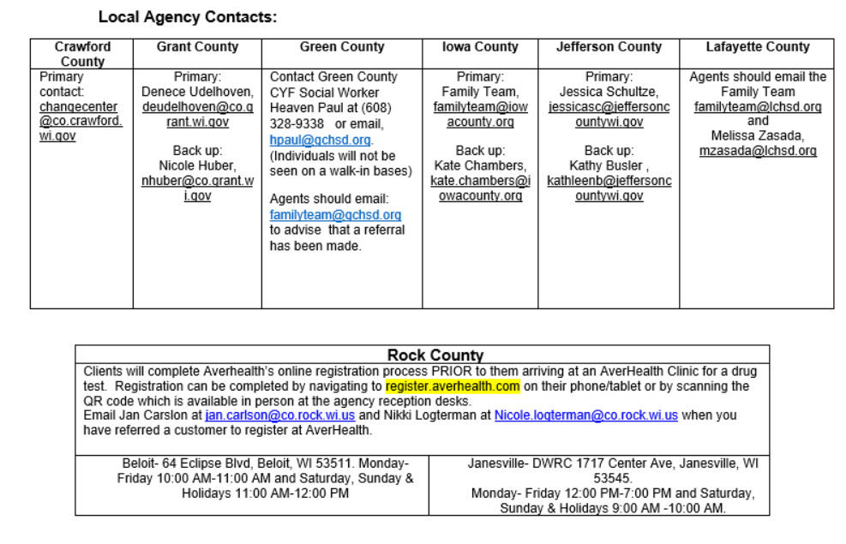
Scheduling
If the customer agrees to take a drug test email the local agency contact:
Refer to the SCC Process Guide
Email the below worker based on county of residence to schedule a drug test. The Local Agency will be responsible for updating case after a drug test is completed or missed.

Slide 8
Case Processing-Ongoing Cases
If a drug felony conviction is reported for an eligible FoodShare member at renewal, or any other time, the worker should schedule a drug test for the member
If a worker discovers that a FoodShare member has a drug felony that was not reported at application, a test is required for continuation of benefits. An IPV should be pursued due to falsifying information at the time of application. Benefits should be recovered from the application date until a negative drug test is received
If an unreported drug felony or incomplete Drug Felon page in an open and ongoing case is discovered:
Notify customer of testing requirement and how to schedule test by mailing the “Notification of Required Drug Testing: F-01542” form
Pend case for drug testing results (30 days): Enter “yes” to the question “Has the Individual agreed to take a drug test,” enter the test date as day 30 and enter a “?”for the corresponding verification to pend eligibility

Slide 9
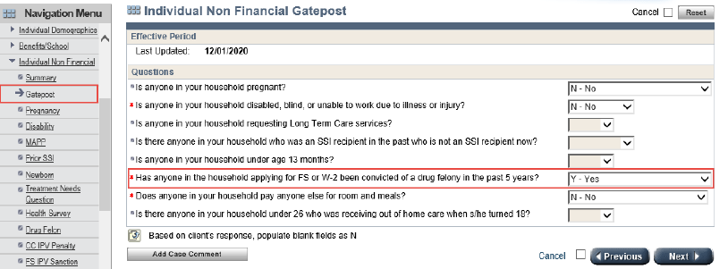
Processing Instructions
After verifying drug felon status, update the “Has anyone in the household applying for FS or W-2 been convicted of a drug felony in the past 5 years” question on the Individual Non-Financial Gatepost page to Yes. Click Next.

Slide 10
Processing Instructions
Update the Drug Felon page as follows:
Select the individual that has been convicted of a drug felony from the drop down
Enter the date the individual was convicted of the drug felony in the Date Felony Conviction Occurred field
Update the “Has the individual agreed to take a drug test?” question to Yes if the individual agreed to take the drug test and No if they did not
If Yes is entered, the “Passed Drug Test?” question is a mandatory entry
If No is entered, the individual is ineligible for FoodShare and is a gross deemer to the FoodShare assistance group
Enter a date in the “Drug Test Date” field and select ?-Not Yet Verified to pend for the drug test date and results
Initiate Eligibility
At application, if the FoodShare eligibility is not pending for any other non-financial or financial verification, workers must run and confirm eligibility open for FoodShare before pending ongoing eligibility for the drug test date and drug test results
Workers must take this same action at renewal when the member is reporting a new drug felony, and when a member is re-requesting FoodShare after a drug felony sanction has ended
A Verification Checklist is sent requesting verification of the drug test date and drug test results along with the verification due date

Slide 11
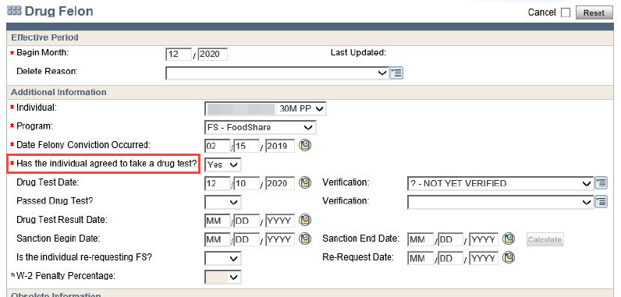

Slide 12
Evaluating and Entering an Accommodation Request
If an applicant/member reports that they are unable to complete the required drug test, IM Agencies must do the following:
Evaluate each situation on a case-by-case basis
Explore all available options to have the applicant/member complete the drug test within their certification period (i.e. extending due dates to complete the test)
If the agency determines there is no way for the member to complete the required drug test due to circumstances beyond the applicant/member’s control, grant the accommodation, exempt the member from the drug test requirement, per agency discretion
Make the following updates on the Drug Felon page:
Enter “Yes” for the “Has the individual agreed to take a drug test?’ question
Enter the date the exemption is granted in the “Drug Test Date field” and NQ-Not Questionable in the Verification field
Enter “Yes” for the “Passed Drug Test?” question and enter NQ-Not Questionable in the Verification field
Document in case comments that the member was exempted from the drug testing requirement due to situations beyond their control, but do not disclose any private, confidential, or HIPPA details as to why

Slide 13
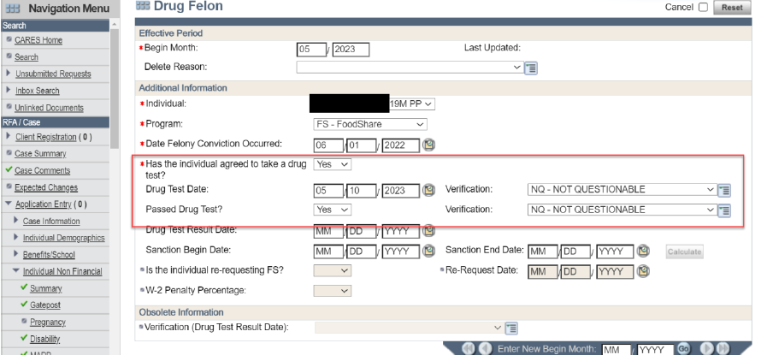
Evaluating and Entering an Accommodation Request

Slide 14
Processing Drug Test Results
When verification is not received by the due date:
Update the “has the individual agreed to take a drug test” question to NO
Remove the date entered in the Drug Test Date field and blank out the verification field
Run and confirm FS eligibility. The member is ineligible for FoodShare and is a gross deemer for the FoodShare assistance group. The member is not sanctioned and can re-request FoodShare and agree to submit to and pass the drug test at a later date

Slide 15
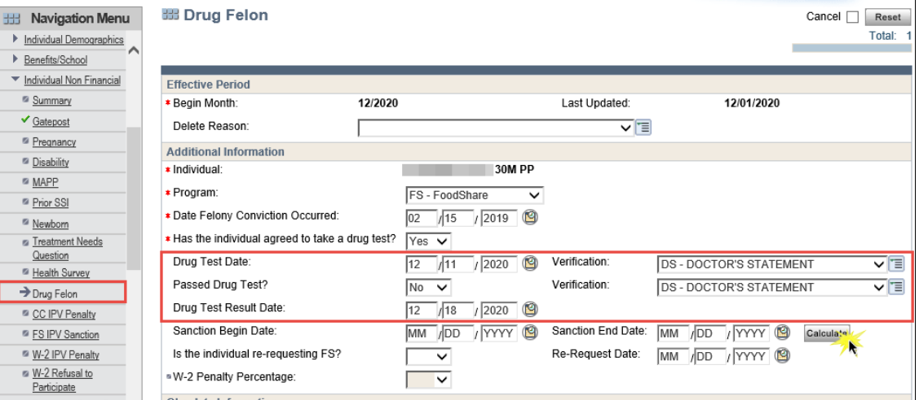
Processing Drug Test Results
When drug test results were received:
If test was taken, update the “Passed Drug Test” question with a Y or N. Enter the date the verification of the drug test results was received in the Drug Test Result Date field. Run and confirm FS eligibility and enter a case comment.
If test was failed, enter “no” and hit the “calculate button” to determine sanction period

Slide 16
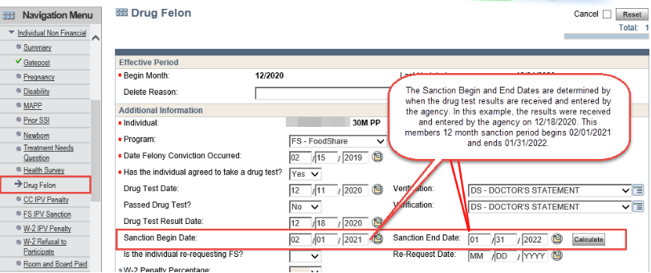
Processing Drug Test Results
The Sanction Begin Date field populates with the first month of the 12 month sanction period in which the member is being sanctioned from FoodShare for not passing the drug test.
The Sanction End Date populates with the last month of the 12 month sanction period in which the member is sanctioned from FoodShare for not passing the drug test.

Slide 17
Regaining Eligibility after 12 Month Sanction Period
To regain eligibility for FoodShare after the 12-month sanction period, the member must re-request FoodShare and submit to another drug test unless five years have passed since the drug felony conviction at the time of reapplication. If five years have not passed since the drug felony conviction, the member continues to be denied until the results of the drug test are received
When a member re-requests FoodShare to regain eligibility after the 12-month sanction period and five years have not passed since the drug felony conviction, workers must take the following actions:
Navigate to the Drug Felon page
Enter the month in which the re-request is being made in the Enter New Begin Month field and click Go
Update the Drug Test Date and enter ?-Not Yet Verified in the Verification field
Update the Passed Drug Test question and the Verification field to a blank
Remove the dates from the Drug Test Result Date, Sanction Begin Date and Sanction End Date fields
Update the “Is this individual re-requesting FS?” question to Yes
Enter the date the member is re-requesting in the Re-Request Date field
Run eligibility and pend FoodShare for the drug test and results
If the member passes the drug test, he or she can be eligible as of the first of the month following the month in which the individual agreed to take the test, and the worker must review the case to determine if a FoodShare supplement is needed. If the member fails the drug test, the member is sanctioned from FoodShare for an additional 12 months

Slide 18
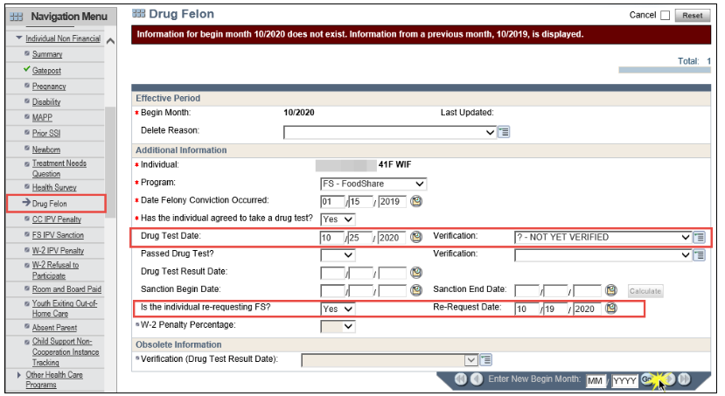

Slide 19
Regaining Eligibility after 12 Month Sanction Period
If five years have passed since the drug felony conviction, an error message displays when the individual is re-requesting FoodShare after the sanction has ended. Workers must take the following actions:
Update the Date Felony Conviction Occurred field to a date that is the first of the month five years ago based on the month the individual is re-requesting FoodShare
Update the “Is the individual re-requesting FS,” question to Yes and enter the Re-Request Date
Run eligibility to determine the individual’s eligibility for FoodShare as of the first of the month following the re-request and ongoing. This may require a FoodShare supplement to be issued depending on the date of the re-request
Navigate back to the Drug Felon page and delete the page with the “Other” reason code
Enter detailed case comments about the re-request for FoodShare after the sanction ended including the update made to the date of felony conviction

Slide 20
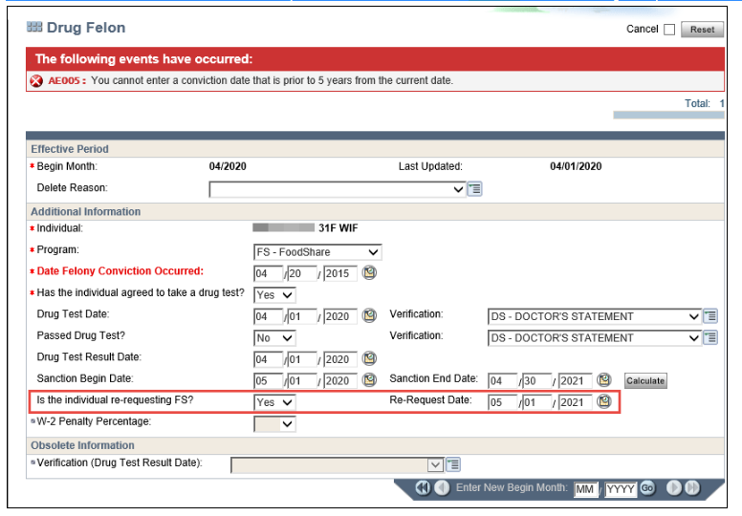

Slide 21
Tips
The Drug Felon policy only applies to FoodShare members who have a felony conviction. Sometimes, members were charged with a felony but convicted of a misdemeanor. It is best practice to check CCAP to verify that the conviction is a felony and to obtain the date of conviction.

