Slide 1
ABAWD
07/27/23

Slide 2
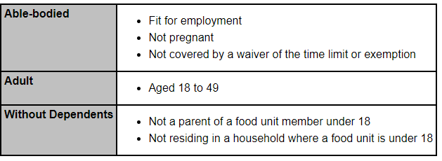
ABAWD- Definition
ABAWD= Able-bodied Adult without Dependents; must meet the FoodShare (FS) work requirement to maintain FS eligibility after receiving three months of time-limited benefits (TLBs) in the current three-year period
Non-ABAWDs=A member who is not an ABAWD, or has a verified ABAWD exemption, is not subject to TLBs and does not need to meet the work requirement

Slide 3
Meeting the Work Requirement
ABAWDS are required to meet both the FS basic work rules and an additional FoodShare work requirement as a condition of eligibility
An ABAWD is meeting the FoodShare work requirement if one of the following applies:
Working a minimum of 80 hours per month (use converted work hours if paid weekly or biweekly)
Participating and complying with an allowable work program at least 80 hours per month*
Both working and participating in an allowable work program for a combined total of at least 80 hours per month
Participating and complying with the requirements of a workfare program
*Allowable work programs include FSET, Refugee Employment and Training, W-2, Trial Employment Match Program (TEMP), Children First, WIOA programs, Refugee Cash Assistance programs, and programs under section 236 of the Trade Act.

Slide 4
Definition of Working
For ABAWDs, working is defined as one of the following:
Work in exchange for money;
Work in exchange for goods or services (“in kind”);
Unpaid work (such as, volunteer work, community service);
Self-employed at any wage; or
Any combination of the above.
*ABAWDs are required to report if their work hours drop below 80 hours per month by the 10th of the month following when the change occurred

Slide 5
Exemptions
Less than 18 years of age or greater than 49 years of age
Has at least one minor (a person less than 18 years of age) in the same food unit
Pregnant
Determined unfit for employment, which includes someone considered any of the following:
Receiving temporary or permanent disability benefits from the government or a private source
Mentally or physically unable to work as determined by the income maintenance (IM) agency
Displaying mental instability, combativeness, or other mental health issues. In this situation, the IM worker should document an exemption without requiring verification from a health care professional.
Verified as unable to work by a statement from a health care professional or a social worker
Experiencing chronic homelessness; a person is chronically homeless if he or she does not expect to have a regular nighttime residence during the next 30 days
Receives unemployment compensation (UC), or has applied for UC, and is complying with UC work requirements
Regularly participates in an alcohol or other drug abuse (AODA) treatment or rehabilitation program
A student of higher education who is otherwise eligible for FoodShare
Primary caretaker of a dependent child under age six or an incapacitated person (may be part of the food unit or in a separate household)
Working 30 or more hours per week or earning wages equivalent to 30 or more hours per week at the federal minimum wage
Complying with Wisconsin Works (W-2) program requirements

Slide 6
Entering an Unfit for Employment Exemption
The “Determined unfit for employment” exemption includes individuals who:
Have applied for or are receiving temporary or permanent disability from a government or private source;
Are mentally or physically unable to work, as determined by the IM agency.
Display mental instability or combativeness;
Have been verified as unable to work by a statement from a health care provider or social worker.
Experiencing chronic homelessness as entered on the Current Demographics page. A person is chronically homeless if they do not expect to have a regular nighttime residence during the next 30 days.
A disability screen must be built for this individual for the system to recognize them as a Non-ABAWD.
If the individual is receiving temporary or permanent disability from a government source, the questions of “Has individual been established disabled by Disability Determination Bureau?”, “Is individual considered disabled for FoodShare” and “Is this individual currently physically or mentally incapable of working?” on the disability screen should all be answered as YES with a verification code of DE- Data Exchange.
If the disability is visibly obvious to the IM or FSET worker or the IM agency is making the determination that the individual is unfit for medical reasons, the question of “Is this individual currently physically or mentally incapable of working?” on the disability screen should be entered as YES with a verification code of VO- Visibly Obvious.
If the client is reporting a possible exemption due to a disability and the IM agency is not making the determination, the question of “Is this individual currently physically or mentally incapable of working?” on the disability screen should be entered as YES with a verification code of ?- Not Yet Verified if verification is needed. The worker should mail form F-01598 Medical Exemption For Work Requirement for ABAWDs to the customer. If verification has already been received, the worker should enter the appropriate verification code.

Slide 7
DDB Determination
Other Determination
Enter the appropriate verification code based on the type of verification that is received. Some examples include: Agency Form, Doctor’s Statement, Visibly Obvious, Other Written, etc.

Slide 8
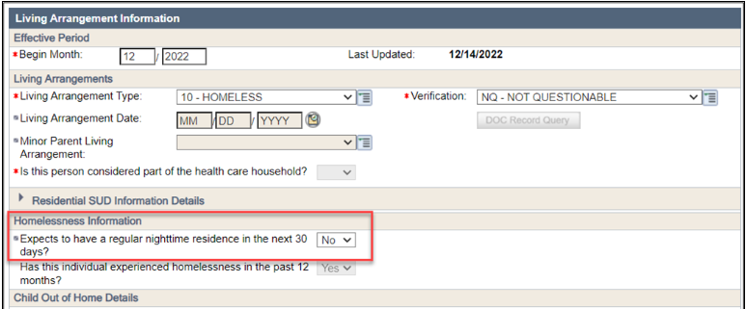
Entering an Unfit for Employment Exemption
Experiencing chronic homelessness. This is indicated by entering the Living Arrangement as 10-Homeless and answering NO to the question Expects to have a regular nighttime residence in the next 30 days?
**** A person who is chronically homeless lacks a fixed, regular nighttime residence and does not expect to have a regular residence in the next 30 days.

Slide 9
Entering an Unemployment Exemption
In order for the Unemployment Exemption to be applied, an unemployment unearned income screen must be built.
If the member is currently collecting UIB, enter the confirmed weekly benefit.
If the member has applied for but is not yet receiving UIB payments, enter $0 for the weekly benefit.
***When ending a UIB screen, you must end date the screen so that the exemption for UIB will end properly.

Slide 10
Entering Other ABAWD Exemptions
Regularly participating in a verified AODA treatment or rehabilitation program. This is indicated by answering YES to Inpatient / Outpatient Drug or Alcohol Treatment on the members benefits received page.
Primary caretaker of an incapacitated person (may be part of the food unit or in a separate household) as verified on the Disability page.

Slide 11
Entering Other ABAWD Exemptions
The following exemptions can be entered on the FS Work Registrant/ABAWD Determination Page:
Complying with W-2 program requirements
The primary caretaker of a child under age 6 out of the home (Parents with children placed in Foster Care or those enrolled in the Fatherhood Initiative are not exempt from the ABAWD requirement).
The primary caregiver of an incapacitated individual outside of the home
Participating in an allowable work program

Slide 12
The FSET Program
The FoodShare Employment and Training program, also known as FSET, is a program that all FS recipients can utilize to gain skills, training, and experience needed to improve employment prospects. The FSET program focuses on identifying the strengths, needs and preferences of job seekers to provided services that will result in employment. FSET also offers FoodShare members a way to meet the ABAWD work requirement.
FSET is a voluntary program and may be utilized by all FoodShare recipients.
ABAWDs may choose to meet the ABAWD work requirement through participation in FSET. Participation in FSET is not a requirement of ABAWDs but is one of the many ways to meet the work requirement.
Non-ABAWDs and ABAWDs who are meeting the work requirement that are over the age of 16 may also choose to participate in FSET.
Several different agencies administer the FSET program across the Southern Consortium. For contact information by county, please refer to the SCC contact listing.

Slide 13
Referral Types
A Referral Type is assigned to every FSET referral. The referral type indicates if the member must participate in FSET in order to meet the ABAWD work requirement.
There are two types of referrals:
Referral Type | Description
Time-Limited Benefits (TLB) | ABAWDs who are not meeting the work requirement must be referred to the FSET program, and they may choose to meet the FoodShare work requirement by participating in FSET. An ABAWD with a TLB referral who enrolls in FSET must participate in qualifying activities in order to meet the FoodShare work requirement and maintain ongoing FoodShare eligibility
Non-Time-Limited Benefits (Non TLB) | ABAWDs who are meeting the FoodShare work requirement outside of FSET, ABAWDs living in an area of the state where the time limit is waived or if they are a tribal member living on tribal land where the time limit is waived, and non-ABAWDs have the option of being referred to FSET.

Slide 14
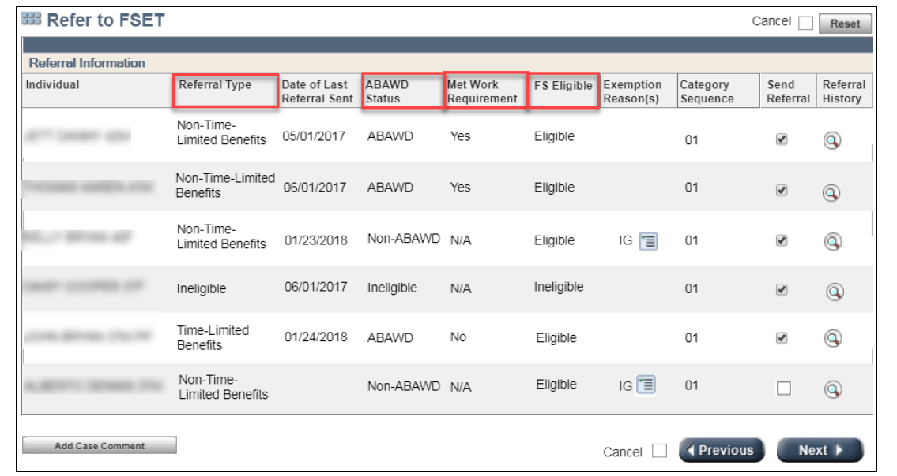
Refer to FSET Page
This screen will display the member’s name, referral type, date referral was sent, Met Work Requirement, FS eligibility, exemption reasons and referral history.

Slide 15
Voluntary FSET Referral
Exempt ABAWDs may request a voluntary referral to the FoodShare Employment and Training program as this program is open to all FS recipients.
To enter a voluntary referral:
Select the Refer to FSET page
Check the box that reads Send Voluntary Referral and click NEXT
***In a case where FS has already been confirmed open you may not have the option to check the box for the voluntary referral. You will need to initiate eligibility and confirm benefits open. Once on the Refer to FSET screen, you will now have the ability to check the box for the voluntary referral.

Slide 16
ABAWD References
FS Policy
3.17.1 ABAWDs
1.2.6 Suggested Verifications
Process Help
Section 71

